Slide 1
ISLAMIC BANKING AND CAPITAL MARKETS ECOSYSTEM IN THE REPUBLIC OF UZBEKISTAN
Overview
March 2023

Slide 2
Part 1 | Islamic Banking in the Republic of Uzbekistan

Slide 3
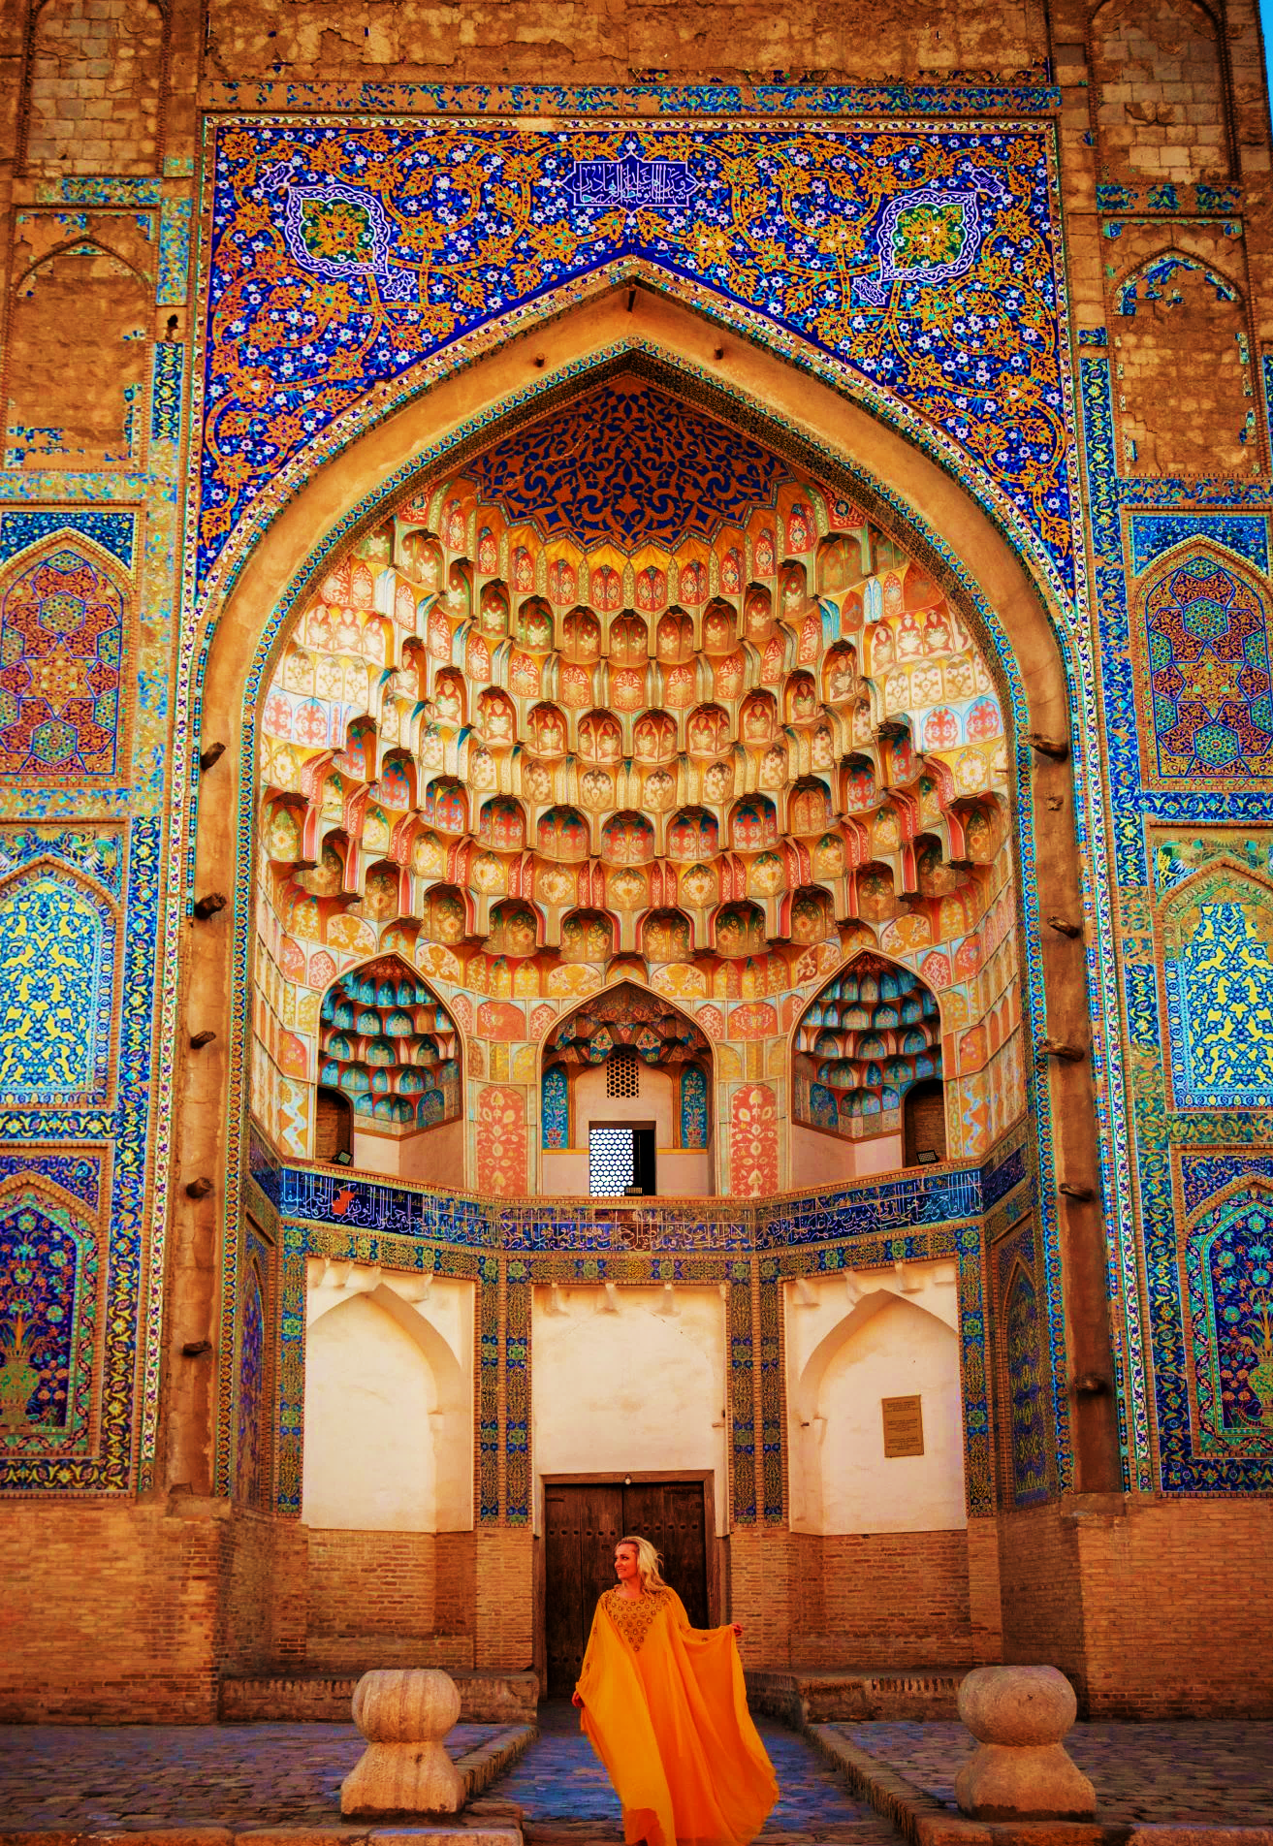
CURRENT STATUS
The Islamic banking and finance ecosystem of the Republic of Uzbekistan is impeded by the absence of an area-specific legislative framework
Current statutory and regulatory acts are adapted to the needs of the conventional banking system
No clear status of contracts and Islamic finance concepts within directly applicable acts of legislation

Slide 4
THERE IS NO SPECIFIC REGULATOR OF THE ISLAMIC BANKING ECOSYSTEM IN THE REPUBLIC OF UZBEKSITAN
Central Bank of the Republic of Uzbekistan
Muslim Board of the Republic of Uzbekistan
Ministry of Finance of the Republic of Uzbekistan
Responsible for the oversight of the banking sector
Limited functions regarding the Islamic financial sector given the absence of a general framework
Limited technical resources in the implementation of Shariah principles
A non-governmental institution with no affiliation with any regulatory bodies
Issues fatwah for Islamic financial services introduced in Uzbekistan
However, it is not vested with any regulatory functions, and is consequently removed from any supervisory powers for the banking sector
Does not engage in the regulation of the banking sector.
Regulates the process for issuance of securities and shares

Slide 5
ISLAMIC BANKS ARE NOT RECOGNISED AS A CONCEPT - THEIR ESTABLISHMENT IS NOT GOVERNED BY A SPECIFIC FRAMEWORK
No conversion or licensing procedures
Purification of Profits (Zakaah)
Conversion procedure
No specific barriers

Slide 6
THE ISLAMIC BANKING ECOSYSTEM IS WIDELY RESTRICTED BY THE ABSENCE OF A CLEAR STATUS OF ITS TRANSACTIONS AND ACTIVITIES
OVERVIEW
The banking regulatory system as applied in Uzbekistan is applicable exclusively to conventional banks, and does not permit Islamic Banks to engage in operations in the mannerutilised in international practice
REGULATORY BARRIERS
No restrictions established by law
However, disposal of profits gained through non-permissible resources in Islamic Finance result in the reduction of capital adequacy (CET2 Capital Adequacy);
No separate profit / loss statements are kept, meaning that separate accounting for Islamic windows may be challenged
Purification of Profits
Activities and Operations
Islamic Banks are technically forbidden to engage in trade transactions, which paralyses the ability to enter into project financing transaction in compliance with Shariah;
There is little flexibility on the investment activities of banks – they can not enter into partnership arrangements (as based on the concept of Musharakah);
No concept of Investment Deposits – they are treated from a conventional perspective
Transactions
Considerable tax risks for banks arise with respect to transactions involving the sale and purchase of assets (eg, Istisna, murabaha-based transactions for real estate);
Banks are equally unable to enter into transactions for funds management on a Wakalah basis – such is not permitted under the Civil Code

Slide 7
THE GOVERNANCE STRUCTURE OF BANKS PREVENTS THE ABILITY TO ESTABLISH AN INTERBANK SHARIAH COMPLIANCE WATCHDOG
General Meeting of Shareholders
Supervisory Board (Bank)
Executive Board
Internal Audit Service
Inspection Commission
Other operational departments (as inclusive of the Shariah Compliance Department)
Shariah Supervisory Boards do not have a status of a governing board Their regulatory and compliance supervisory functions are limited
Shariah Supervisory Boards may be recognized as normal operational departments of a Bank, meaning that its decisions may be overridden by other governing bodies by law

Slide 8
Part 2 | Capital Markets and Sukuk

Slide 9
THE PERIOD FOR EXPOSURE TO ISLAMIC CAPITAL MARKETS OCCURS DURING THE LATER STAGE OF A COMPANY’S FINANCING LIFECYCLE
Family, Friends, and fools (FFF)
VENTURE CAPITAL: PRE-SEED / SEED Rounds
Mezzanine / Expansion financing
ISSUANCE OF BONDS / SUKUK
INITIAL PUBLIC OFFERING (IPO)

Slide 10
UZBEK CAPITAL MARKETS ARE DOMINATED BY THE STATE-OWNED ISSUERS, WITH THE PRIVATE SECTOR’S ROLE GROWING RAPIDLY IN RECENT YEARS
Overview of Legal Acts
Key Observations
112
37%
Securities traded on the national stock exchange (i.e., Tashkent Stock Exchange) are predominantly shares.
Companies listed on the national stock exchange
Listed Companies with direct state-owned equity
State-owned enterprises listed on the national stock exchange are key players in the strategic sector of the economy (public transportation, oil & gas and utilities).
14
2
Banks listed on the national stock exchange
Privately-held companies engaging in the listing of bonds on the national stock exchange
No active institutional framework for the issuance of Sukuk bonds

Slide 11
APPROXIMATE STRUCTURE OF SUKUK ISSUANCE – BASE STRUCTURE
Investors
Originators
Proceeds for the purchase of Sukuk
Sale of assets
Buy-back of assets upon maturity of sukuk
SPV
Issuance of Sukuk
Direct ownership of the assets (Registered ownership)
Issuance of Sukuk
Real Estate
Moveables
Transfer of Assets

Slide 12
ALTERNATIVE STRUCTURE – SUKUK + LEASING (SUKUK AL IJARAH)
Sale of assets
Originator
Investors
Rights of lease of assets
Acquisition of sukuk + Beneficial Ownership of Assets
SPV
Leasing of the asset
Issuance of Sukuk
Use of the asset on the basis of lease arrangements
Direct ownership of the assets
Issuance of Sukuk
Real Estate
Moveables
Transfer of Assets

Slide 13
THE CURRENT RULES ESTABLISHED UNDER THE CIVIL LEGISLATION OF THE REPUBLIC OF UZBEKISTAN RENDER SUKUK ISSUANE TRANSACTIONS UNIMPLEMENTABLE
Current provisions
The concept of beneficiary ownership is not recognized under Uzbek Law The rights of ownership with respect to an asset are only valid upon their registration in the name of the entity submitting such registration The entity designated in the registry is deemed to be the full owner
Originator
Investors
Equity Ownership
Payments
No registered title to the assets
No registered title to the assets
SPV
Title of ownership with respect to the real estate objects
Assets

Slide 14
CURRENCY CONTROL LEGISLATION RESTRICTS THE ABILITY OF UZBEK ORIGINATORS TO INCORPORATE SPV COMPANIES ABROAD
Current provisions
Foreign investments undertaken by residents in favour of foreign entities are recognized as movement capital operations and are subject to regulation Formation of capital in foreign legal entities is allowed in the amount not exceeding 10,000 USD Any investments exceeding this threshold are permitted provided that the relevant approval of the Cabinet of Ministers or the President of the Republic of Uzbekistan is obtained Such threshold restrictions are applicable to cash calls, shareholder loans and acquisition of assets Restrictions in incorporation and financing SPVs
Originator
Blocking of operations by the Bank
<10,000
USD
Transfer of Funds is approved
Approval of the Cabinet of Ministers is obtained
>10,000
USD
Transfer of Funds is approved
SPV

Slide 15
SUKUK STRUCTURES ARE COMPLICATED FROM THE PERSPECTIVE OF TAXATION, AND LEAD TO SUBSTANTIAL TAX CONSEQUENCES (1/2)
Investors
Originators
Value-Added Tax – 15%
Corporate Income Tax (if buy-back is at below the par value of assets) – 15 – 20%
Proceeds for the purchase of Sukuk
Corporate Income Tax (if buy-back is at below the par value of assets) – 15 – 20%
Sale of assets
Buy-back of assets upon maturity
SPV
Issuance of Sukuk
Direct ownership of the assets (Registered ownership)
Property Tax (for immoveable property) – 1,5%
VAT (12%)
Issuance of Sukuk
Real Estate
Moveables
Transfer of Assets

Slide 16
SUKUK STRUCTURES ARE COMPLICATED FROM THE PERSPECTIVE OF TAXATION, AND LEAD TO SUBSTANTIAL TAX CONSEQUENCES (2/2)
Sale of assets
Value-Added Tax – 15%
Originator
Investors
Rights of lease of assets
Acquisition of sukuk + Beneficial Ownership of Assets
SPV
Leasing of the asset
Issuance of Sukuk
Corporate Income Tax (if buy-back is at below the par value of assets) – 15 – 20%
Property Tax (for immoveable property) – 1,5%
Use of the asset on the basis of lease arrangements
Direct ownership of the assets
Issuance of Sukuk
Real Estate
Moveables
Transfer of Assets

Slide 17
THE CONSTANT TRANSFER OF ASSETS OR FUNDS AND ASSETS BETWEEN THE SPV AND THE ORIGINATOR MAY SUBJECT THE STRUCTURE TO TRANSFER PRICING RISKS
Current provisions
Transfer Pricing Notice rules The entitlement of tax authorities to request documents Reduced price flexibility is a risk
Controlled Transaction 1 – Transactions to Offshore Jurisdictions
Originators
SPV
Sale of assets
Controlled Transaction 2 – Related Party Leasing Transactions
SPV
Originator s
Lease of Assets

Slide 18
THANK YOU VERY MUCH!
KEY CONTACTS
Jakhongir Usmonov Senior Associate
Email: Jakhongir.usmonov@centil.law
Mob: +998 90 982 00 71
Centil Law Firm
12 A Turkistan Str | Platform Business Center
Tashkent 100060 Uzbekistan
+998931204778
uzbekistan@centillaw

